Slide 1


Let’s Talk About Data Science
An Introduction for data Science in R
Presented by: Dhiraj Kumar

Slide 2
Outlines
About Data Science: What is Data Science
About R: What is R
Set up R & RStudio
Data Resources
Examples Machine Learning Tools
Case studies : Titanic Survival

Slide 3
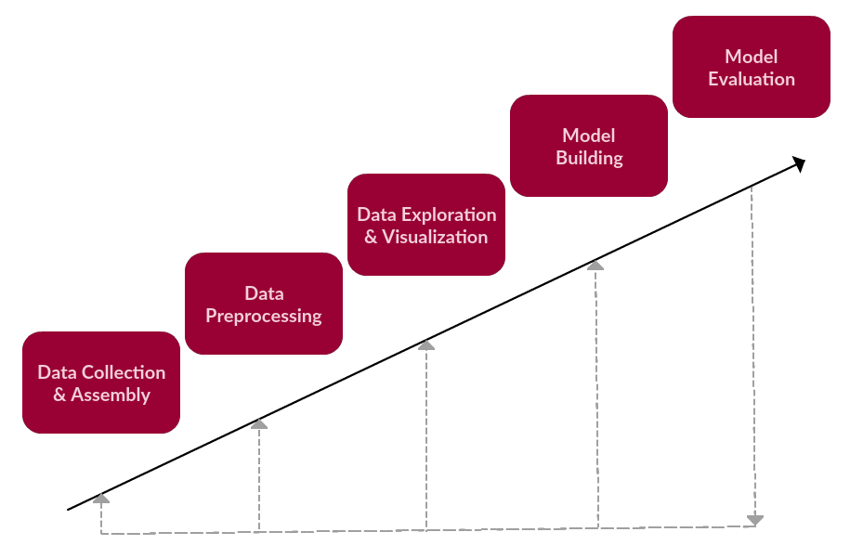
Data Science : Step By Step

Slide 4
Data warehousing
Artificial Intelligence
Data Management
Data and Text Mining
Statistics
Big data
Database
Analytics
Data Scientist
Privacy and security
Data Product Design
Computer Science
Business Mindset
Cloud Computing
Ethics
Programming
Domain Knowledge

Slide 5
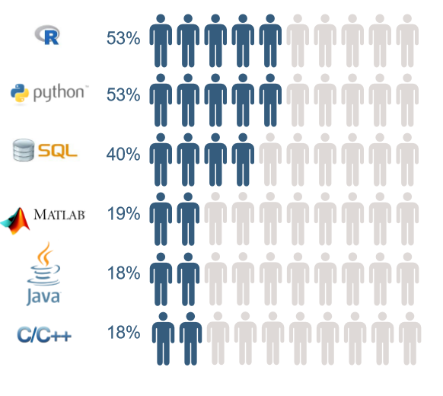
About R & RStudio
R Language
R is a free software environment for statistical computing and graphics. It compiles and runs on a wide variety of UNIX platforms, Windows and MacOS.
Data science in 2018

Slide 6
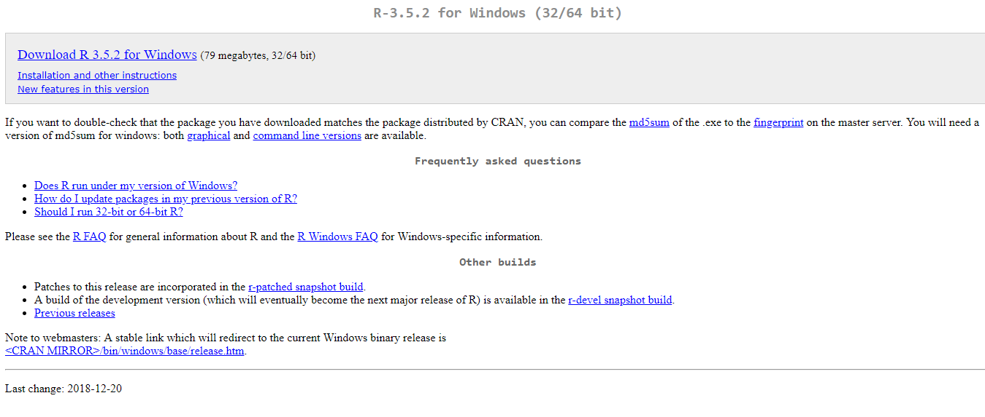
Set up R
Link: https://cran.r-project.org/bin/windows/base/

Slide 7
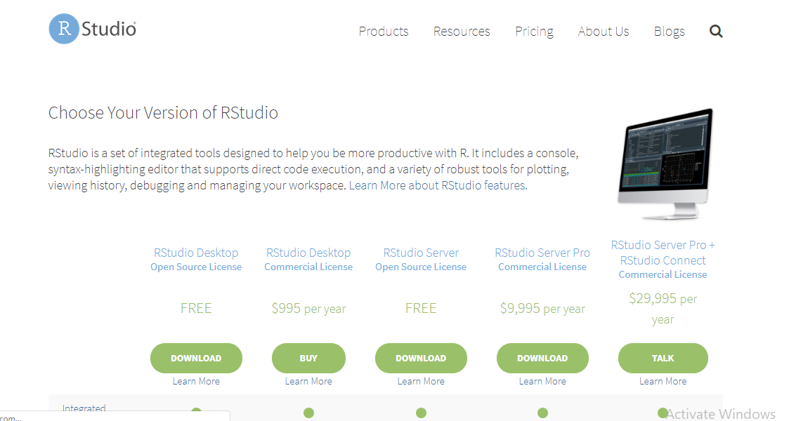
Set up RStudio
Link: https://www.rstudio.com/products/rstudio/download/

Slide 8
R Characteristics
R is a open source and free.
R has lots of package and multiple ways of doing the same thing.
By default stores memory in RAM.
R has the advance graphics. You need much better programming skills.
R has GUI to help make learning easier.
Customization needs command line.
R can connect to many database and data types.

Slide 9
Try it !
Simple Maths
> 2 + 2 ## Addition operation in R
4
Storing results into variables
> x <- 2 + 5 ## <- is R syntax for = or assignment operation
> x
7
Vectorized maths
> Weight <- c(110, 180, 240) ## three weights
> Height <- c(5.5, 6.1, 6.2) ## three heights
> Bmi <- ( Weight*4.88) / Height ^ 2 ##divide element wise
17.4 23.6 30.4

Slide 10




Getting Data in
from Files
> df <- read.csv( “data.csv”, header = TRUE)
from Database
> con <- dbConnect(driver, user, password, host, dbname)
> df <- dbSendQuery(con, “ SELECT * FROM data ”)
from the Web
> con <- url( “http://labs .dataspora.com/test.txt ”)
> df <- read.csv(con, header = TRUE)
from R Objects
> load(‘iris’)

Slide 11



Getting data out
to Files
> write.csv(df, file = “df.csv”)
to Database
> con <- dbConnect(driver, user, password, host, dbname)
> dbWriteTable(con, “df” ,df)
to R Objects
> save (df, file =“ df.csv”)

Slide 12
Data Processing
Load data & view it
> install.packages(“MASS”)
> library(MASS)
> head(iris) ## display first 6 rows
> dim(iris) ## display number of rows & columns
Write it out
> write.csv(iris, file =“iris.csv”, row.names = FALSE)
View it in Excel make a change , save it
Remove the first district
Load it back in to R & plot it
> iris <- read.csv(file = “iris.csv”)
> plot(Species ~ Petal.Length, data = iris)

Slide 13
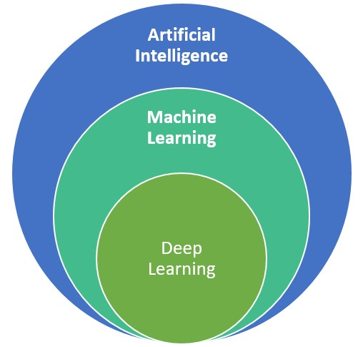
Artificial Intelligence
Any Technique which enable computers to mimic human behavior .
Machine Learning
Subset of AI techniques which use statistical methods to enable machines to improve with experiences.
Deep Learning
Subset of ML which make the computation of multi-layer neural network feasible.

Slide 14
Type of Machine Learning
Machine Learning
Supervised
Unsupervised
Reinforcement
Labelled data
direct feedback
Predict outcome/ future
No labels
No feedback
Find the hidden structure in data
Decision process
Reward system
Learn series of actions

Slide 15
Machine Learning Algorithms
Unsupervised
Supervised
Continuous
Clustering & Dimensionality Reduction
Regression
Linear
Polynomial
Decision Trees
Random Forests
SVD
PCA
K means
Categorical
Association Analysis
Apriori
FP-Growth
Hidden Markov Model
Classification
KNN
Trees
Logistic Regression
Naive Bayes
SVM

